Slide 1


SafeComp 2020
DepDevOps 2020
Towards a DevOps approach in Cyber Physical Production Systems using Digital Twins
Miriam Ugarte, Mondragon Unibertsitatea
15/09/2020

Slide 2
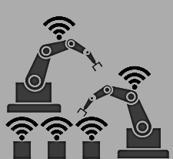
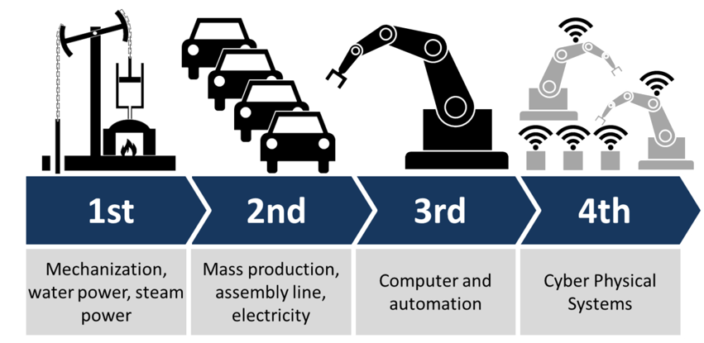
Industry Evolution
Performance
Customisation
4th
Cyber Physical Systems
Automated
production
3rd
Mass
production
Agile
Dynamic
2nd
Customised
Digitisation
ICT, electronics
Flexible
Mechanical production
Reconfigurable
1st
Electricity
Water, steam
powered machines
Time

Slide 3

Industry 4.0
Requirements
Challenges
Flexible
Seamless
Adaptive
Reconfigurable
Dynamic
Legacy architecture
Hardware constraints
Interoperability issues
Collaborative framework

Slide 4
Objective
Agile and Continuous evolving Cyber Physical Production System
DevOps principles
Code
Build
Integrate
Test
Release
Deploy
Operate
DevOps
Continuous Deployment
Continuous Delivery
Continuous Integration

Slide 5



Proposal
Using the Digital twin for a Devops approach
Digital Twin
Digital Twin
Design
Engineering
Commissioning
Operation
Service
Product life cycle

Slide 6
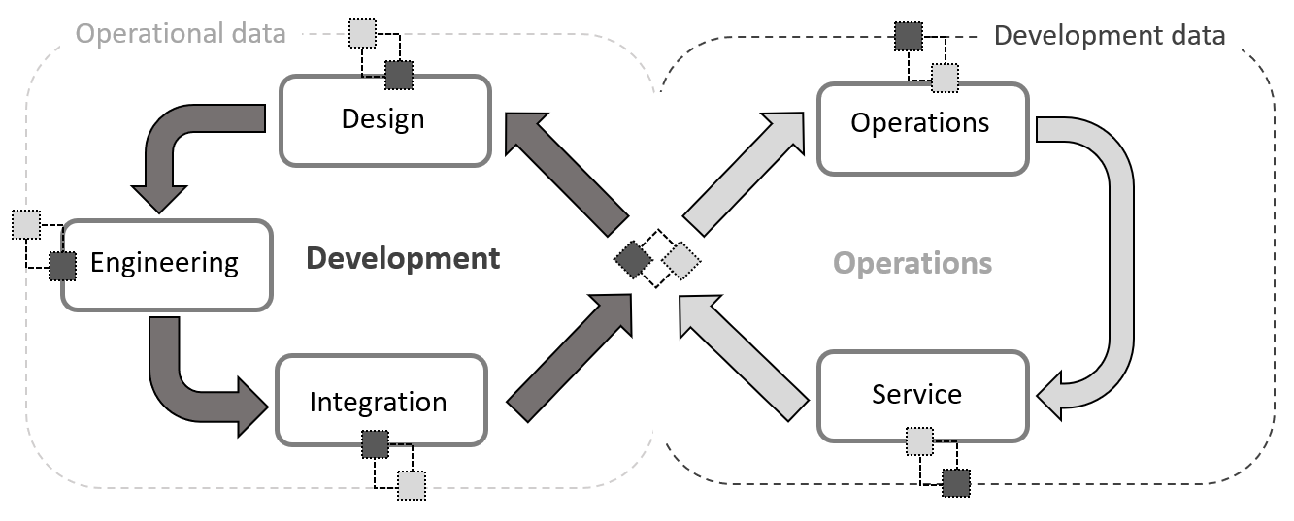
Digital twin for a DevOps approach
Digital
Twin

Slide 7
Digital twin for a DevOps approach
Development

Slide 8
Digital twin for a DevOps approach
Development
Requirements
Operation
Product
Digital Twin
V&V
Virtual integration
System Integration
System design
V&V
mechanical
System
electrical
Engineering
automation

Slide 9
Digital twin for a DevOps approach
Development
Requirements
Operation
Product
Digital Twin
System Validation and Verification
Optimisation of the product
V&V
Virtual integration
System Integration
System design
V&V
mechanical
System
electrical
Engineering
automation

Slide 10
Digital twin for a DevOps approach
Development
Requirements
Operation
Product
Digital Twin
V&V
Virtual integration
System Integration
System design
V&V
mechanical
System
Collaborative framework
What if scenarios
Secure environment
electrical
Engineering
automation

Slide 11
Digital twin for a DevOps approach
Development
Requirements
Operation
Product
Digital Twin
V&V
Virtual intergration
System Integration
Virtual Commissioning
Secure environment
Continuous deployment
System dessign
V&V
mechanical
System
electrical
Engineering
automation

Slide 12
Digital twin for a DevOps approach
Operations

Slide 13
Digital twin for a DevOps approach
Operations
System Operation Optimisation
Decision making under unexpected scenarios
Runtime verification and validation
Operations

Slide 14
Digital twin for a DevOps approach
Operations
Service
Monitoring system, real time status
Preventive maintenance
Traceability of the supply chain
Training and learning

Slide 15
Conclusions and Future Work
Digital twin, a step forward towards DevOps due to its agile framework for a continuous development and operations of the production systems
Benefits:
Less time to market.
Lower development costs.
Better performance of the production line.
Lower failure rate and downtime of the production line.
Solving interoperability issues
Early detection of design and engineering errors, failures or malfunctions
Future
work:
Standards and interfaces definition

Slide 16
Thank you
Miriam Ugarte Querejeta
mugarte@mondragon.edu
Acknowledgements
This work was accomplished by the Software and Systems Engineering research group of Mondragon Unibertsitatea (IT1326-19), supported by the Department of Education, Universities and Research of the Basque Government, and the DiManD Innovative Training Network (ITN) project. DiManD ITN is an European Training Network (ETN) programme funded by the European Union through the Marie Sktodowska-Curie Innovative Training Networks (H2020-MSCA-ITN-2018) under grant agreement number no. 814078

