Slide 1


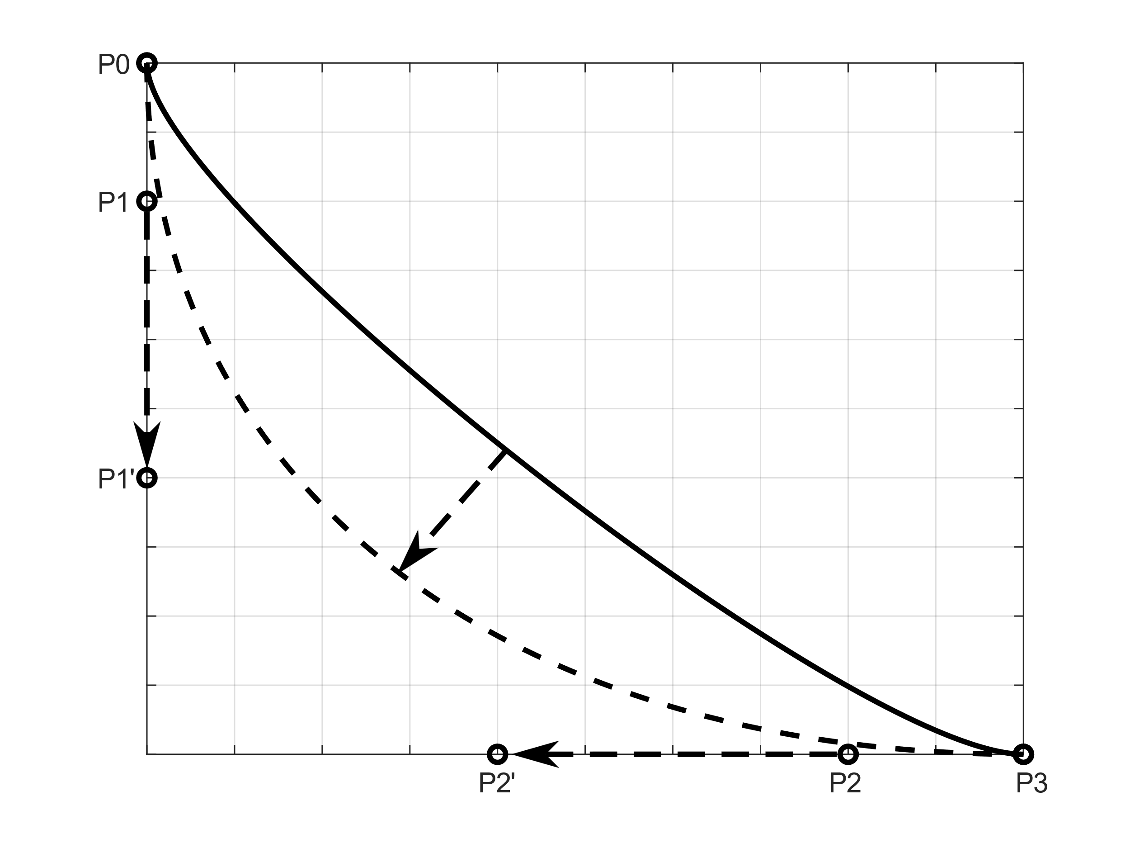
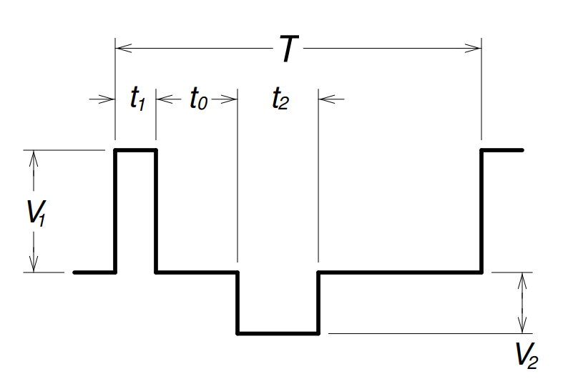
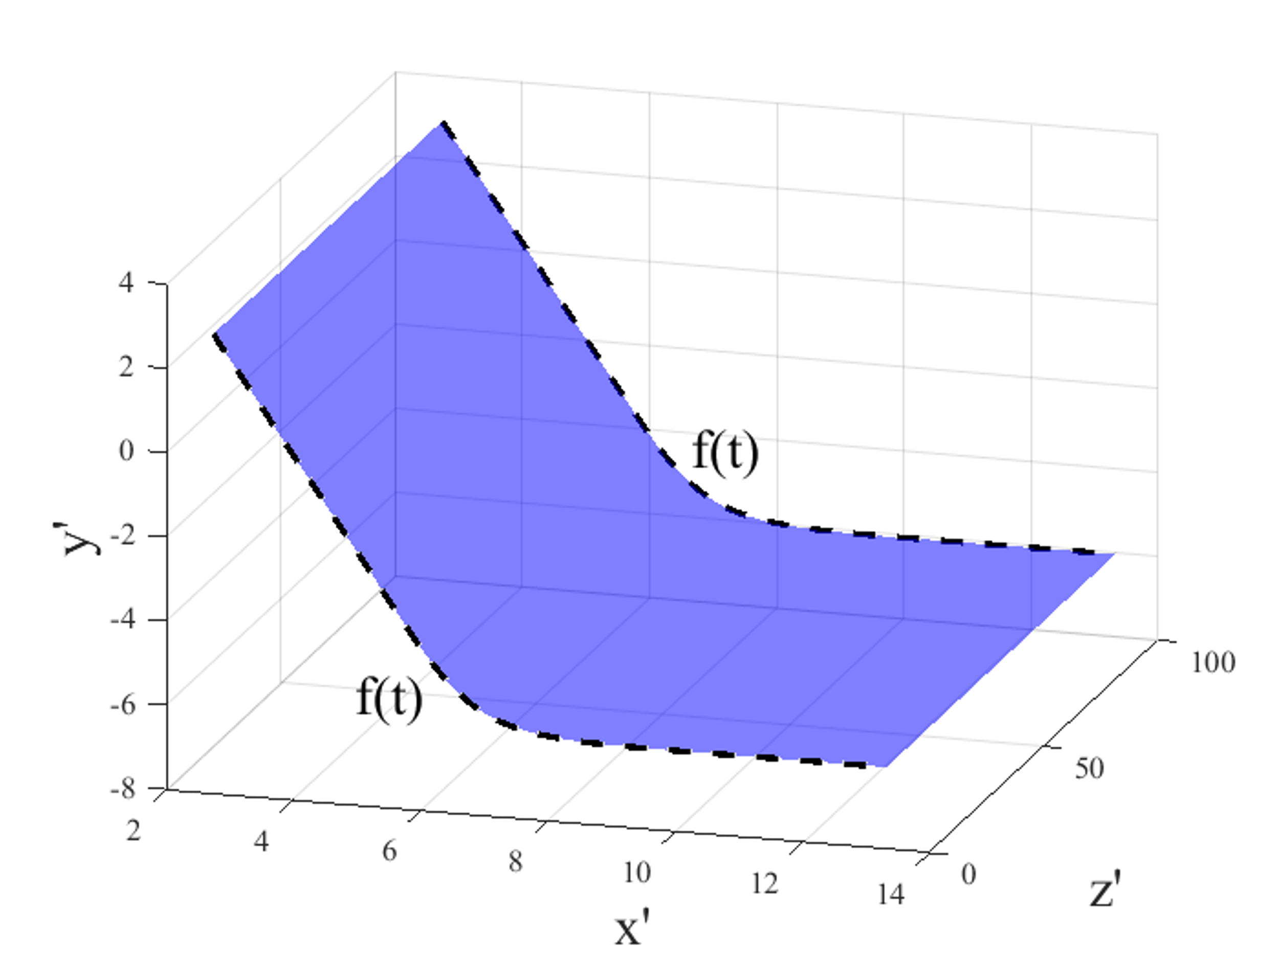
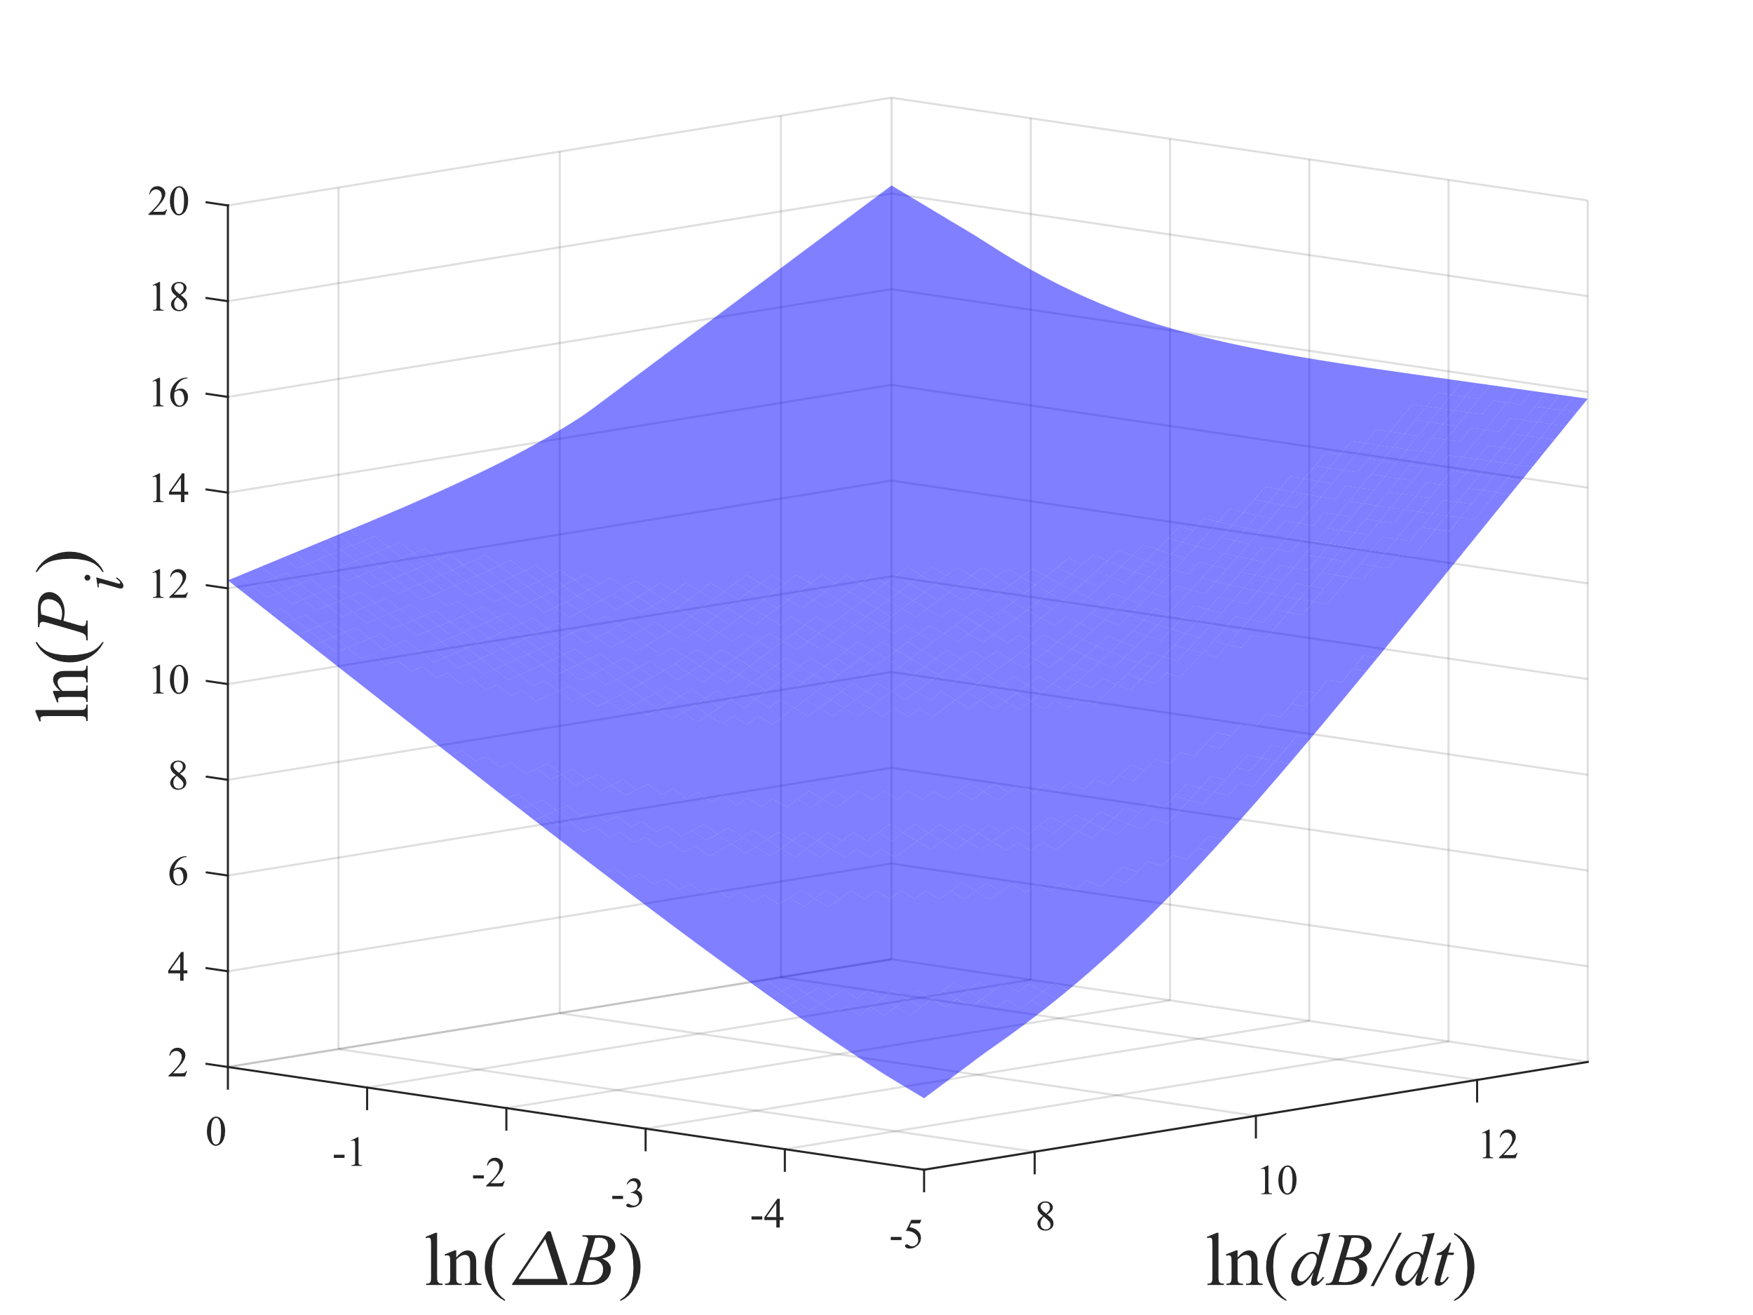

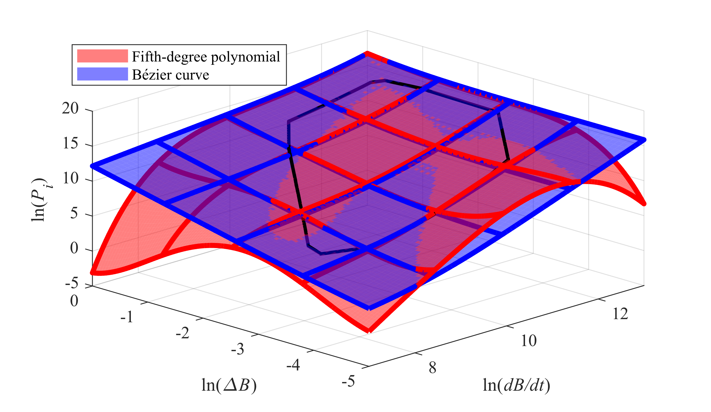
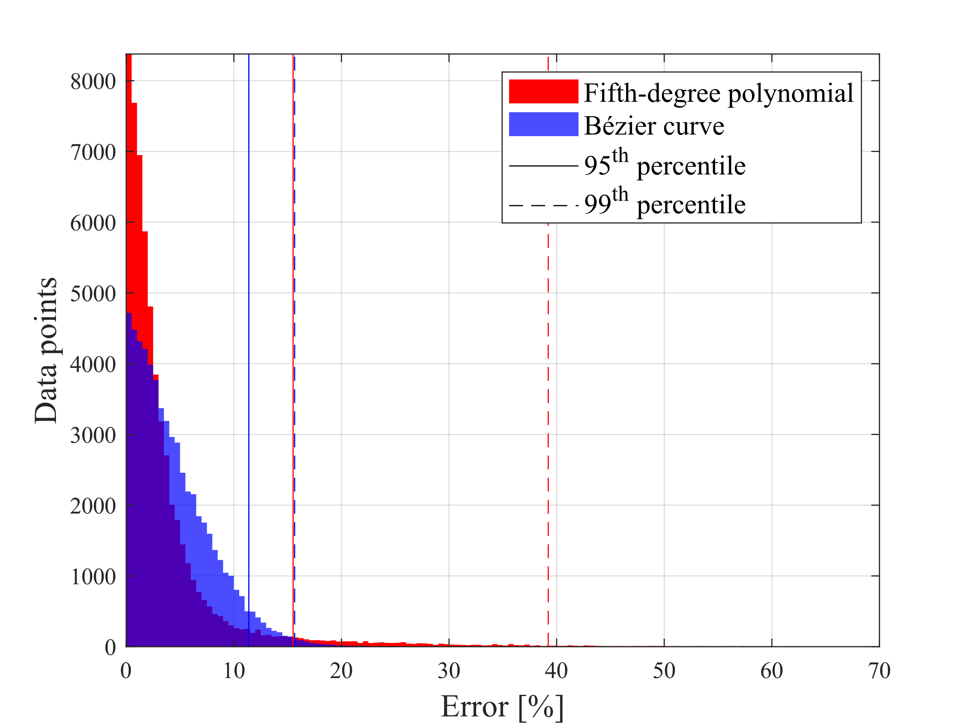


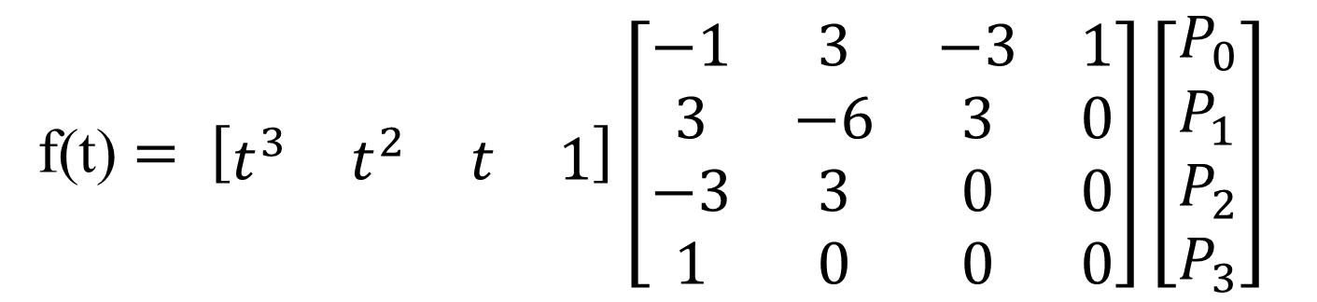
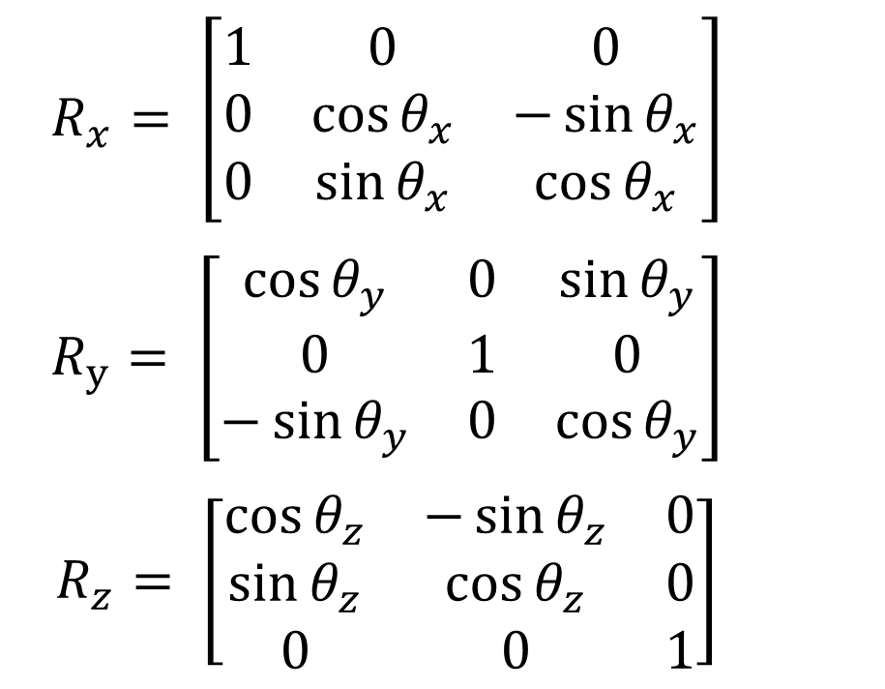
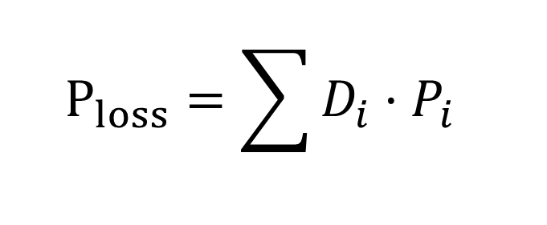

Alternative Approach Based on Bézier Curves to Model
Core Losses With the Composite iGSE Method
Anartz Agote, Asier Arruti, Iosu Aizpuru, Mikel Mazuela
Electronics and Computing Department, Mondragon Unibertsitatea, Hernani, Spain
anartz.agote@alumni.mondragon.edu
INTRODUCTION
The estimation of power losses in magnetic components is critical in switching mode power systems (SMPS). For the common waveforms in SMPS, several models have been proposed, considering various concepts, as iGSE [1]. The model presented in a previous work [2] introduces a new model, ciGSE, which uses a fifth-degree polynomial surface to define the loss space. This model provides relatively accurate estimations when extrapolations are not needed and requires 21 parameters for each material to define the model. Building on that work, the model has been improved by incorporating Bézier curve concepts.
BÉZIER CURVES
CWH
Bézier curves are parametric curves commonly used in computer graphics, used to define the form of a curve in a range. To build this model the cubic Bézier curve is considered [3]. This curve can define its traceability and the tangents in the extremes by 4 control points.
The Composite Waveform Hypothesis (CWH) says that the total losses of a waveform can be simplified by sectioning the waveform into composites [4]. For each segment, the losses are calculated from the same loss space and finally the sum of each loss the total loss can be obtained.
f(t) $= \left[\begin{matrix}t^{3} & t^{2} & t & 1\end{matrix}\right]\left[\begin{matrix}−1 & 3 & −3 & 1 \\ 3 & −6 & 3 & 0 \\ −3 & 3 & 0 & 0 \\ 1 & 0 & 0 & 0\end{matrix}\right]\left[\begin{aligned}P_{0} \\ P_{1} \\ P_{2} \\ P_{3}\end{aligned}\right]$
$$P_{loss}=\sum{D_{i}·P_{i}}$$
MODEL ALGORITHM
$$P0,X′, P0,Y′, P1,X′, P1,Y′,$$
$$P2,X′, P2,Y′, P3,X′, P3,Y′,$$
$$θ_{X} \& θ_{Y}$$
$$R_{x}= \left[\begin{matrix}1 & 0 & 0 \\ 0 & {\cos{θ}}_{x} & −\sin{θ_{x}} \\ 0 & \sin{θ_{x}} & \cos{θ_{x}}\end{matrix}\right]$$
$$R_{y}= \left[\begin{matrix}\cos{θ_{y}} & 0 & \sin{θ_{y}} \\ 0 & 1 & 0 \\ −\sin{θ_{y}} & 0 & {\cos{θ}}_{y}\end{matrix}\right]$$
$$R_{z}= \left[\begin{matrix}{\cos{θ}}_{z} & −\sin{θ_{z}} & 0 \\ {\sin{θ}}_{z} & \cos{θ_{z}} & 0 \\ 0 & 0 & 1\end{matrix}\right]$$
Select the parameters of the material
Create 2D loss space
Rotate the loss space
into original 3D axes
Find the losses in the loss space
RESULTS
[5]
X10 materials
N87 at 25 ºC
CONCLUSIONS
REFRENCES
The model is…
more robust over the whole range, and its accuracy does not vary drastically, ensuring good performance in extrapolations.
more compact and simpler, reducing the number of parameters to define the model from 21 to 10.
[1] K. Venkatachalam, C. R. Sullivan, T. Abdallah and H. Tacca, "Accurate prediction of ferrite core loss with nonsinusoidal waveforms using only Steinmetz parameters," 2002 IEEE Workshop on Computers in Power Electronics, 2002.
[2] A. Arruti et al, "The Composite Improved Generalized Steinmetz Equation (ciGSE): An Accurate Model Combining the Composite Waveform Hypothesis With Classical Approaches," in IEEE Transactions on Power Electronics, vol. 39.
[3] Mortenson, Michael E., “Mathematics for Computer Graphics Applications,” Industrial Press Inc. p. 264. ISBN: 9780831131111.
[4] C. R. Sullivan, J. H. Harris, E. Herbert, “Core loss predictions for general PWM waveforms from a simplified set of measured data,” in proc. IEEE Applied Power Electrononics Conference and Exposition (APEC), 2010.
[5] H. Li et al., "How MagNet: Machine Learning Framework for Modeling Power Magnetic Material Characteristics," in IEEE Transactions on Power Electronics.

